Slide 1



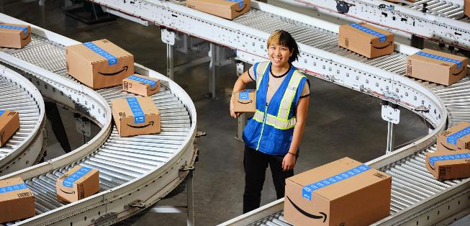
Trustworthy
Shopping
EUIPO Case Law Conference May 2026
2026 Amazon.com, Inc. or its affiliates. All rights reserved.

Slide 2
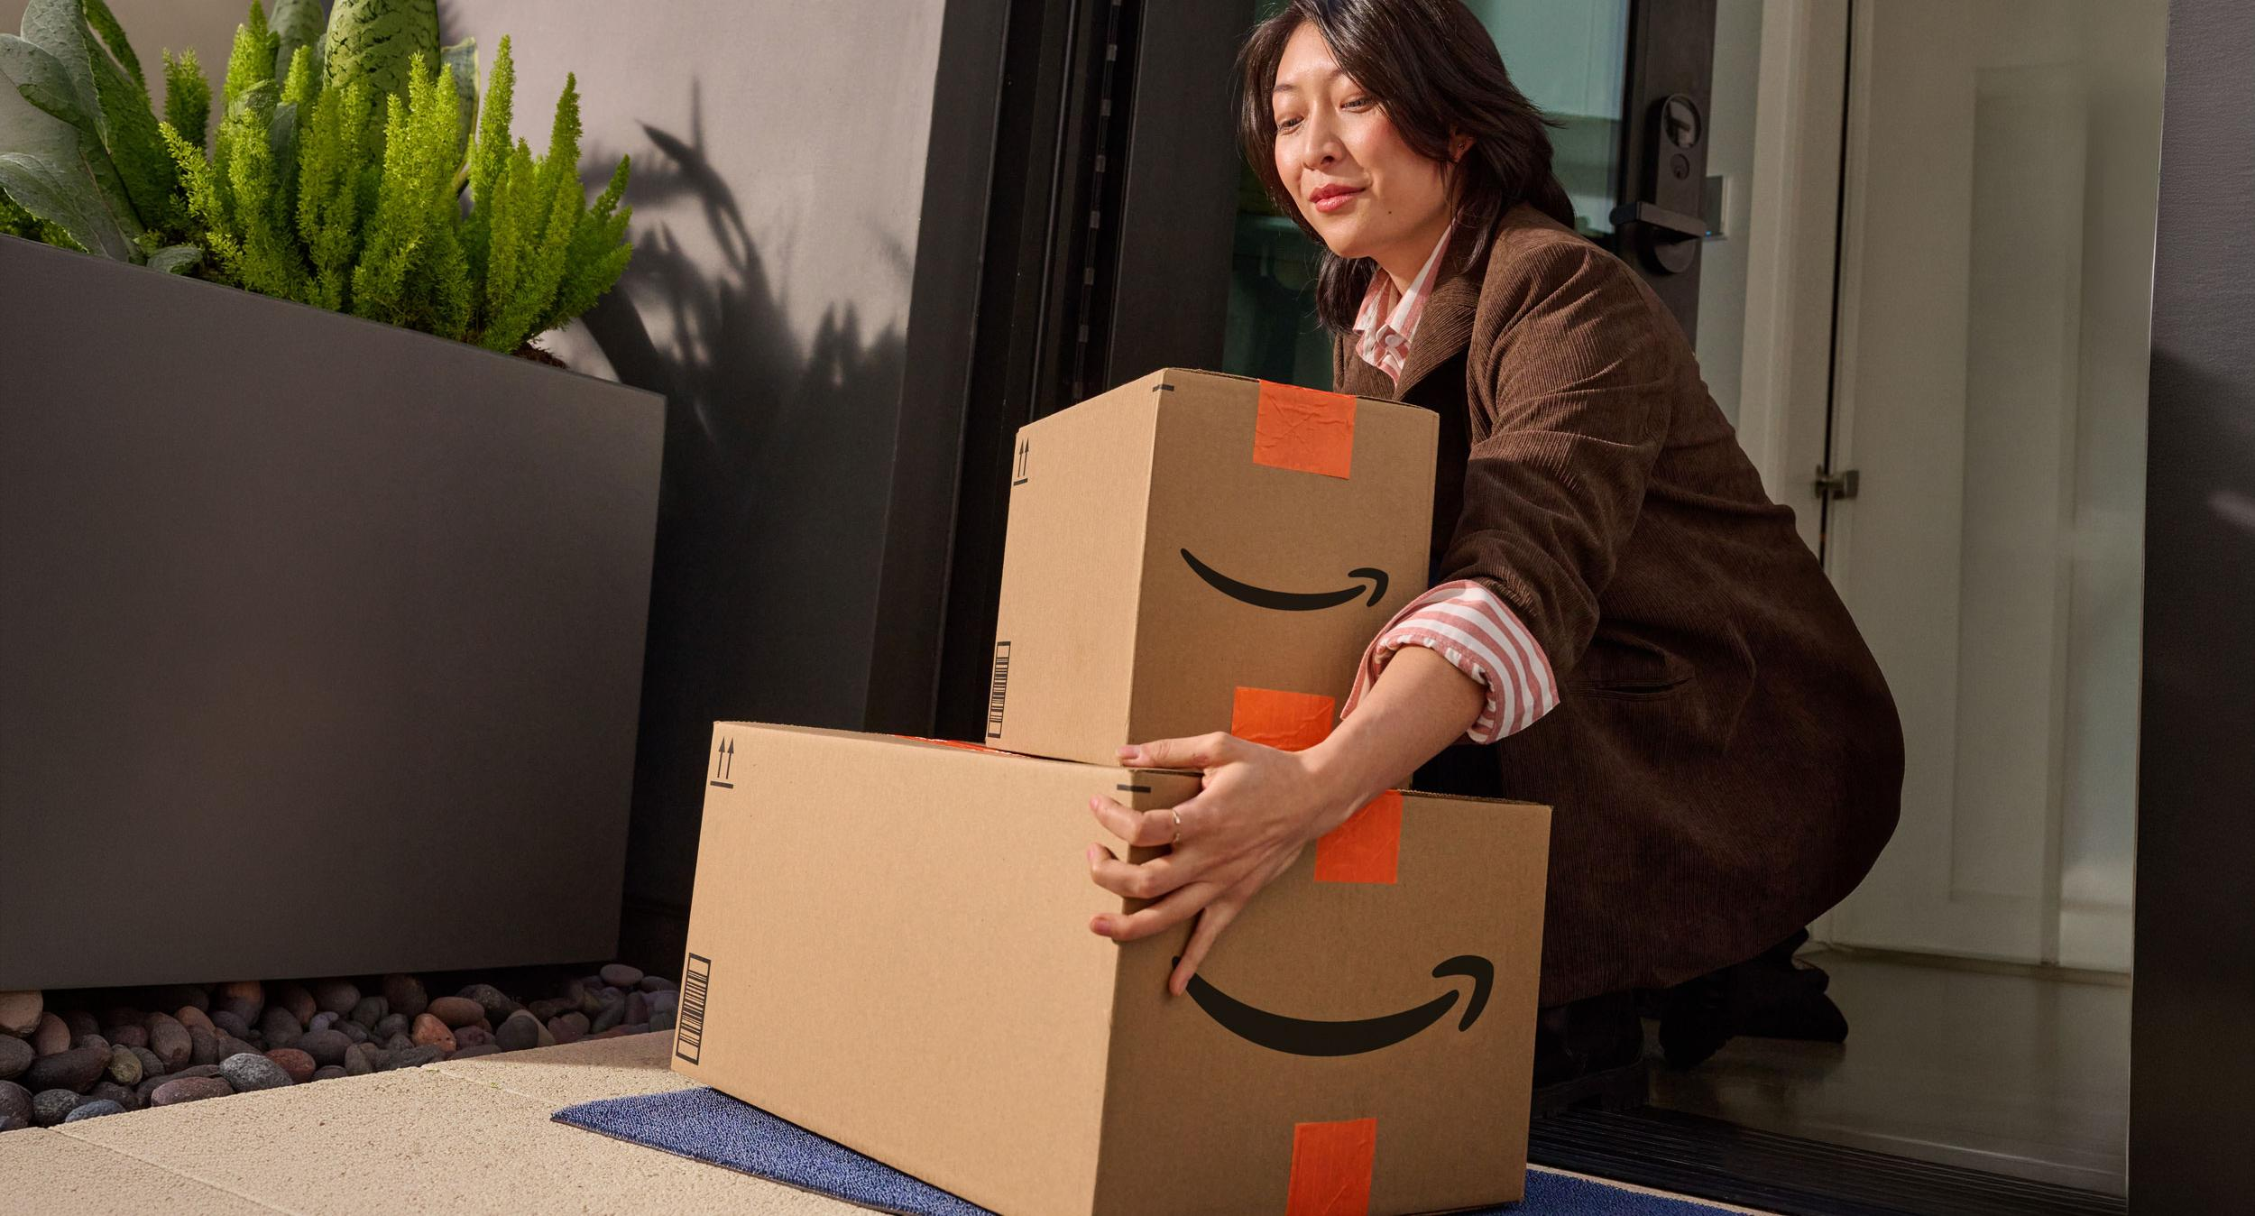
Trust is the foundation
Amazon’s mission is to be the Earth’s most customer-centric company – and that starts with trust.
2026 Amazon.com, Inc. or its affiliates. All rights reserved.

Slide 3

How we protect customers
Robust proactive controls
Innovative tools and technology
Holding bad actors accountable
Protecting and educating consumers

Slide 4

Robust
Proactive
Controls
Section 01
2026 Amazon.com, Inc. or its affiliates. All rights reserved.

Slide 5

Stopping problems before they start
100% of new sellers are required to complete a robust verification process.

Slide 6

Innovative tools and technologies
Section 02
2026 Amazon.com, Inc. or its affiliates. All rights reserved.

Slide 7




How we verify sellers
Sellers must provide:
Government-issued IDs
Business credentials
Bank
statements
Proof of
address
All cross-checked against internal and external databases.
2026 Amazon.com, Inc. or its affiliates. All rights reserved.

Slide 8

Supporting sellers with transparent processes
We work to make registration
and reverification transparent, predictable, and straightforward for legitimate sellers.

Slide 9
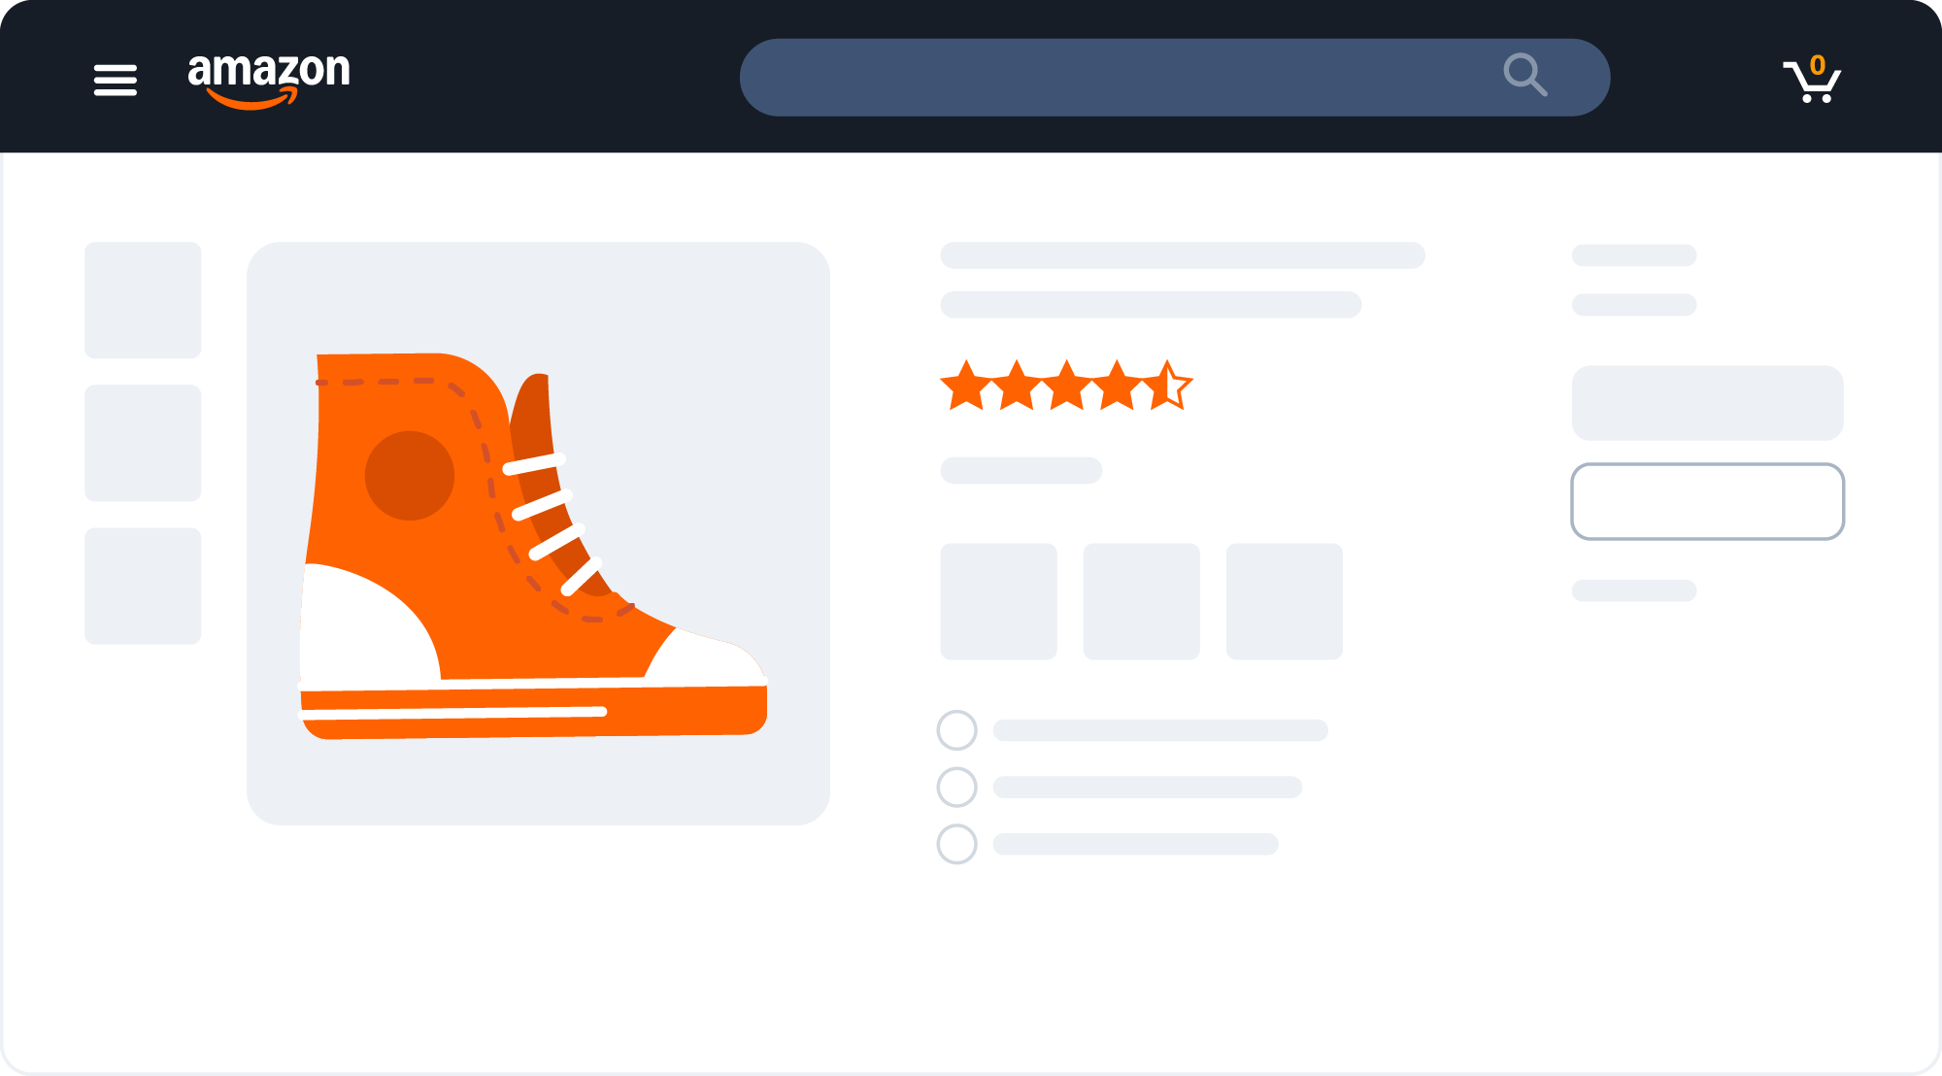

Protecting intellectual property and brand authenticity
Amazon's automated technology and artificial intelligence (AI) scans billions of attempted changes to product detail pages daily
for signs of potential abuse.
Amazon’s proactive controls blocked more than 99.9% of suspected infringing listings before a brand owner ever had to find and report them.

Slide 10

Worldwide
Empowering customers to report concerns before purchase
The "Report an issue
with this product or seller" feature gives customers a simple, direct way to flag concerns from any
product page.

Slide 11

Europe
Digital Product Passports: Supporting the EU’s vision for digital product information
The EU's upcoming Digital Product Passports (DPPs) will replace paper labels with a unified digital standard for product information — and Amazon is integrating DPP capabilities into its existing infrastructure to make compliance simpler for selling partners and the shopping experience more transparent for customers across the EU Single Market.

Slide 12





Tools that empower brands
Amazon Patent Evaluation Express
Brand
Registry
Transparency
IP Accelerator
Project Zero

Slide 13

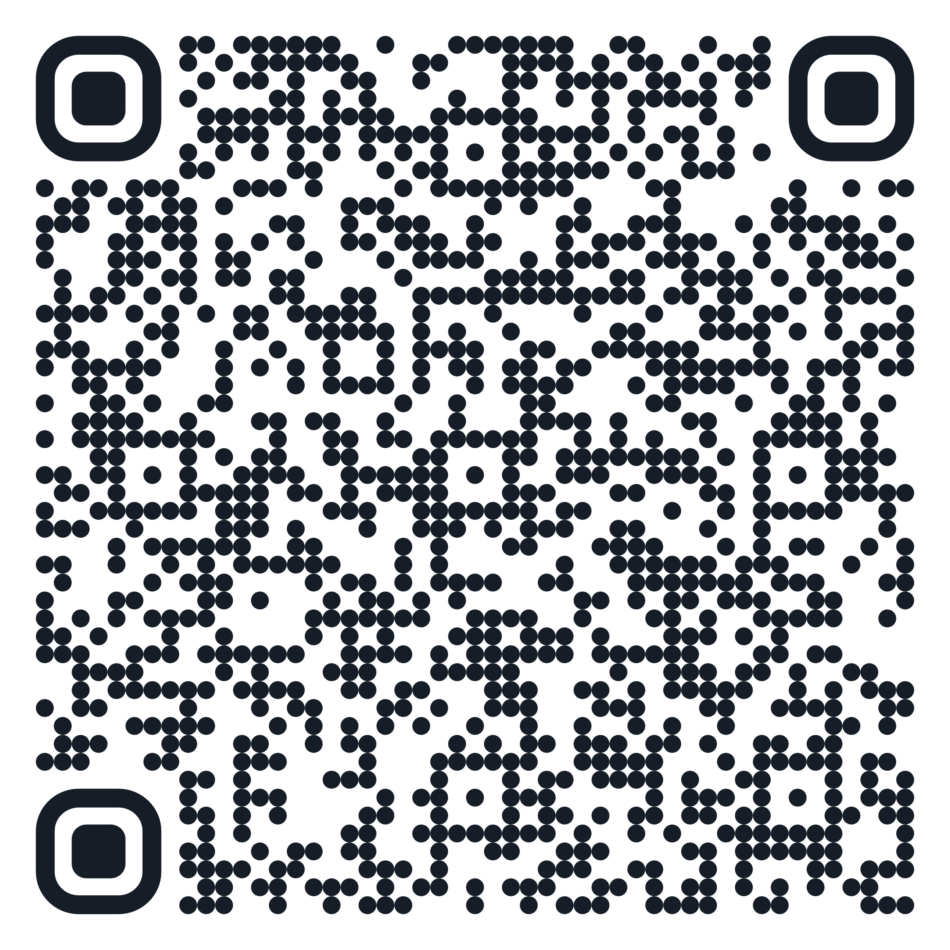
Thank you
Scan to learn more about how we are constantly innovating and improving to protect customers and selling partners.

